Slide 1

PA 881
International cost benefit analysis

Slide 2
Introduction to PA 881
Today:
getting to know each other
course details – syllabus, Canvas, topics
Past projects

Slide 3
Introduction to PA 881 – instructor
Instructor: Dr. Emilia Tjernström
Email: tjernstroem@wisc.edu
Office hours: Mondays 9:30-11:30
Office: Taylor Hall 520
Notes:
Anyone who can never make that time?

Slide 4
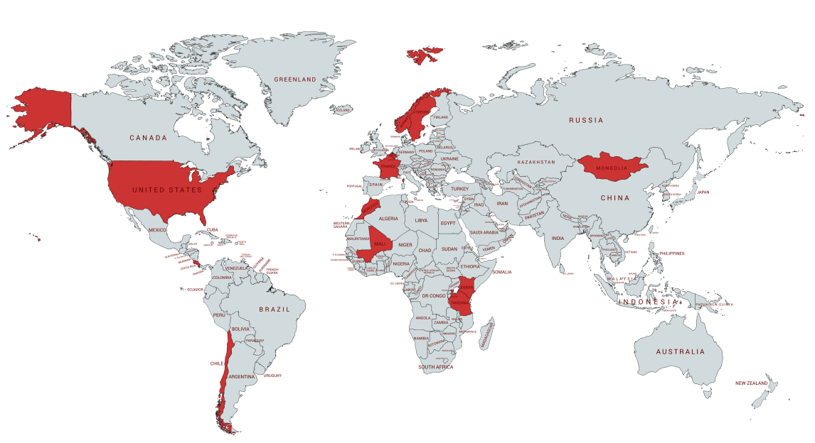


Slide 5



Slide 6
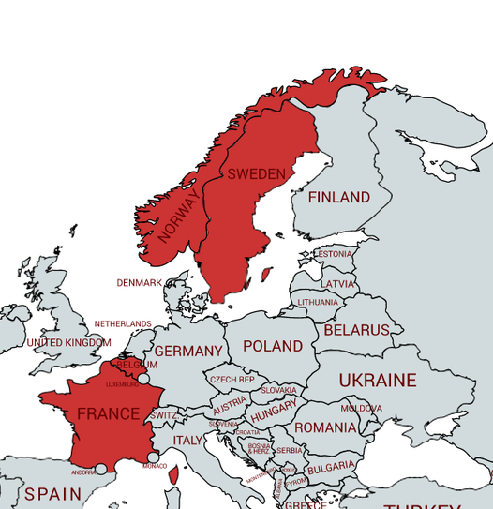

Slide 8
Enough about me!
Name tags
Preferred pronouns
Country or regional interests?
Topics of interest?
What talent do you have that you think nobody appreciates nearly as much as they should?

Slide 9
Introduction to PA 881 – readings
Required book: Anthony E. Boardman, David H. Greenberg, Aidan R. Vining, and David L. Weimer, Cost- Benefit Analysis: Concepts and Practice, 5th ed. (Upper Saddle River, New Jersey: Prentice Hall, 2018).
[BGVW]
Other materials on the course website (and occasionally on Canvas)
Notes:
Rules

Slide 10
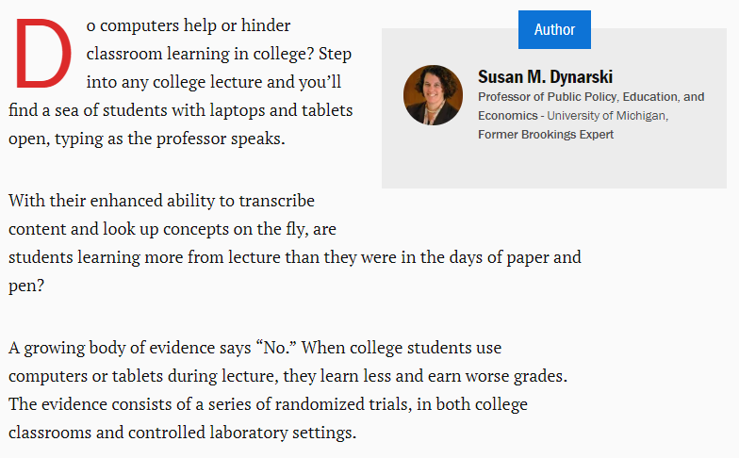
Source: https://www.brookings.edu/research/for-better-learning-in-college-lectures-lay-down-the-laptop-and-pick-up-a-pen/
Notes:
* Randomly assigned to note take on laptop or by hand! Randomization ensures that on average the students using electronics in a study are comparable to those who aren’t. Those who took notes on laptops understood the material worse.
* Students using a laptop also distract their colleagues.
* Real-world: United States Military Academy (USMA): electronics, no electronics, tablets flat on table (same teacher teaches several sections)

Slide 11
Assessment & grading
Discussions & class participation (15%)
Frequent online quizzes (10%, drop lowest 2)
Stata exercise (5%)
Midterm exam (30%)
CBA project (40%)
A: 93 and above
AB: 87-92.99
B: 83-86.99
BC: 77-82.99
C: 70-76.99
D: 60-69.99
F: below 60
I expect you to keep track of the assignments using the calendar feature. If I forget to remind you at the end of class, it’s not an excuse to miss a deadline!
Notes:
Discussions in class – require reading prior
Retrieval practice is important for learning
Want to be cognizant of different learning styles & that not everyone is equally comfortable speaking in class – can boost participation grade through online discussions
Still need to attend
Drop lowest
Quizzes due Mondays for first half of semester and then a bit more sporadically as you get more into your projects
Some problem sets will use Stata
Lots of resources on campus for learning Stata; I will also make a handout

Slide 12
CBA project
Project report 1 (summary + plan) – September 19
Project report 2 (annotated bibliography) – Oct 10
Project report 3 (categories & measurement) – Oct 18
Project consultations – Nov 21
Team reports due Dec 7
Presentations Dec 10 & 12
Revised report due on Dec 19, explaining revisions
Peer review
Notes:
Discussions in class – require reading prior
Retrieval practice is important for learning
Want to be cognizant of different learning styles & that not everyone is equally comfortable speaking in class – can boost participation grade through online discussions
Still need to attend
Drop lowest
Some problem sets will use Stata
Lots of resources on campus for learning Stata; I will also make a handout

Slide 13
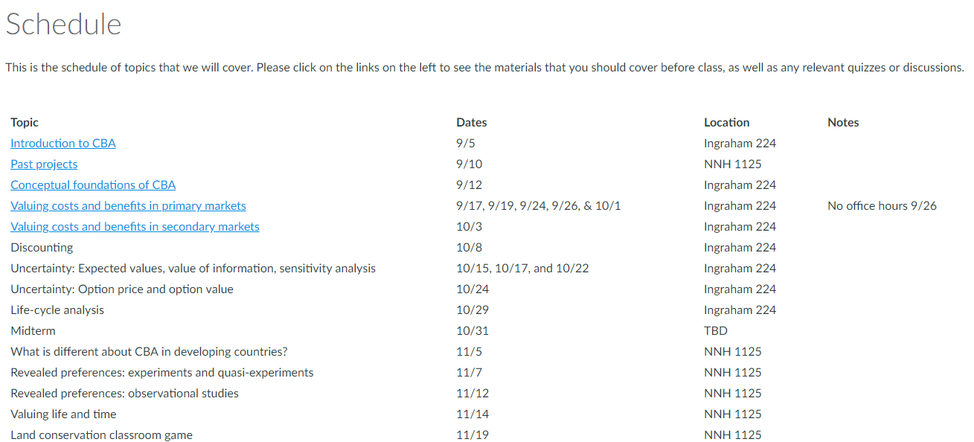
Canvas
Please submit assignments with logical titles, ideally Assignment_ProjectName.pdf
https://canvas.wisc.edu/courses/103383/

Slide 14
New resource on Google Scholar & data
Getting started with teams & Google resources (also linked from Schedule page)

Slide 15
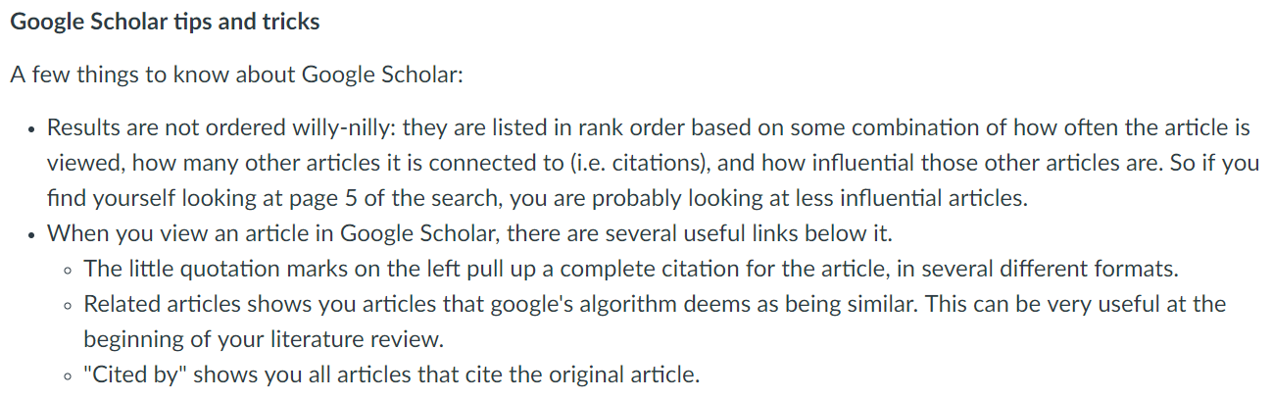
New resource on Google Scholar & data

Slide 16
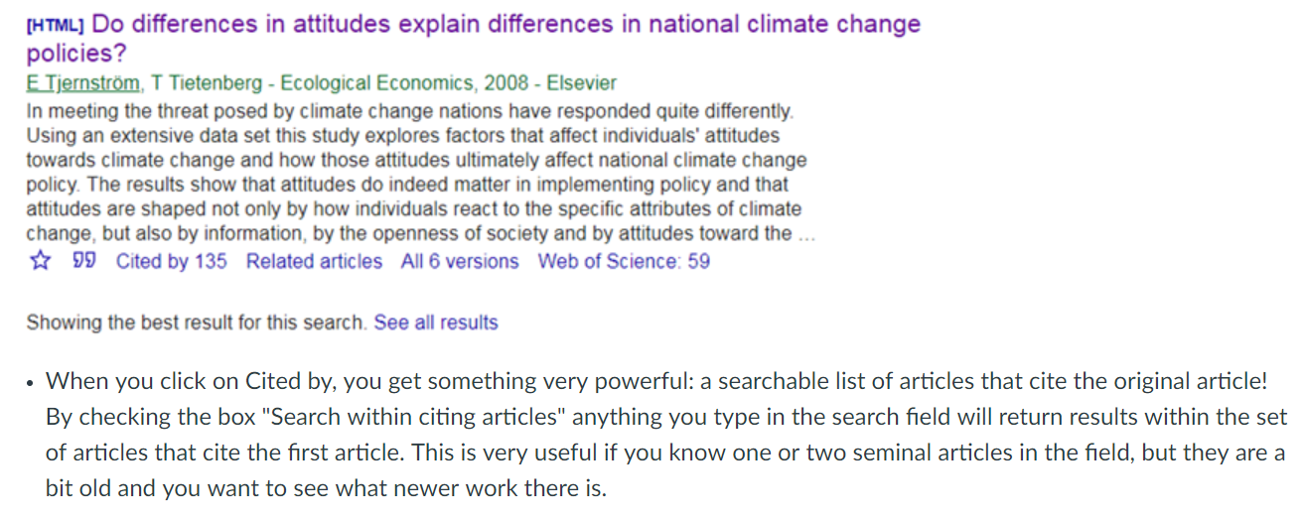
New resource on Google Scholar & data

Slide 17
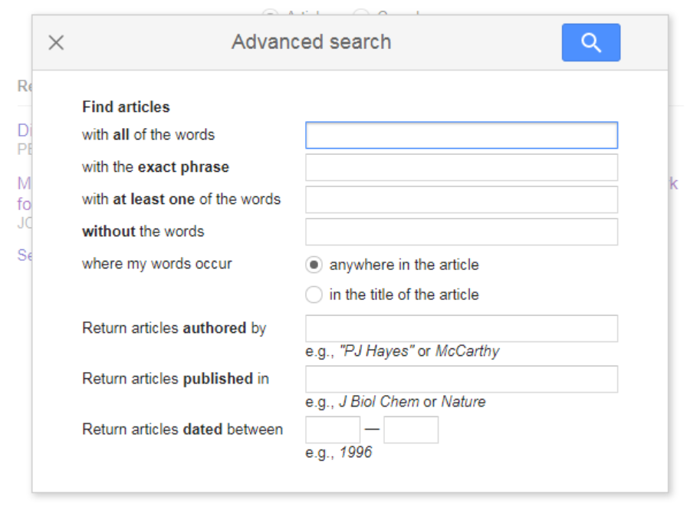
New resource on Google Scholar & data

Slide 18
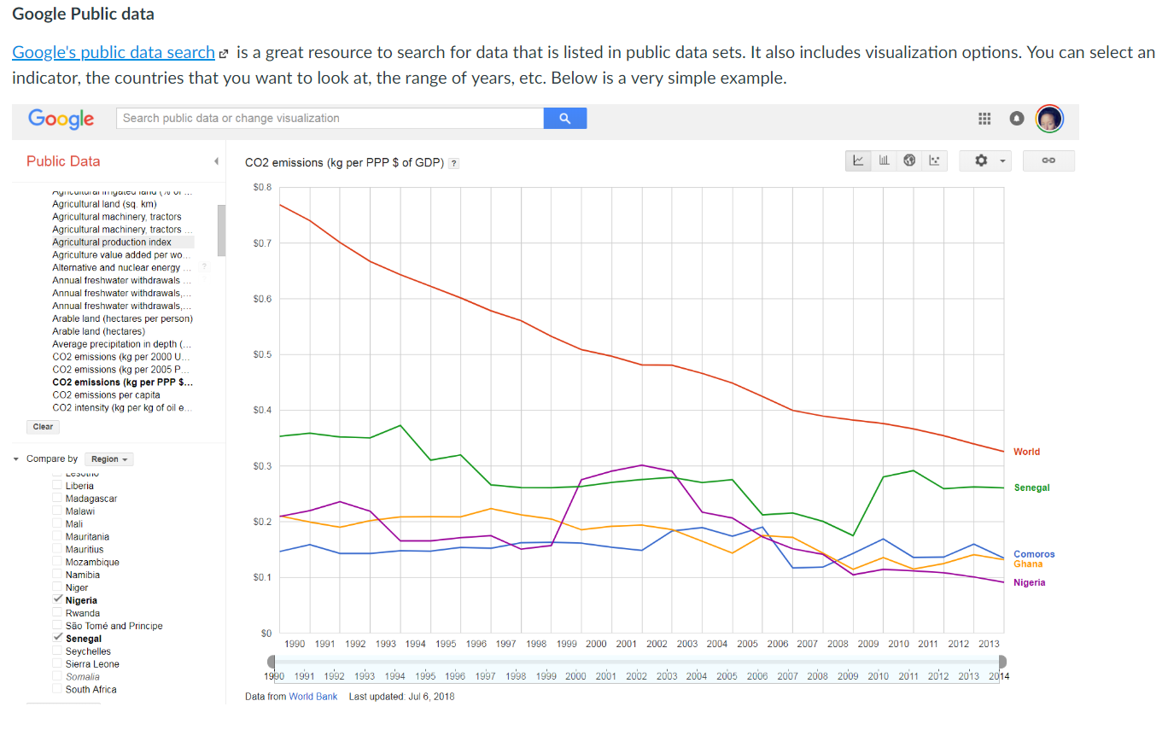
New resource on Google Scholar & data

Slide 19
Questions?

Slide 20
Topics
Why might CBA be different in developing countries?
Revealed preferences
experiments & natural experiments
observational studies
Valuing life & time
Land conservation exercise
Valuing the environment
invasive species
case study: Comoros
contingent valuation
Implications of behavioral econ
Conceptual foundations
Valuing B&C in primary markets
Valuing B&C in secondary markets
Discounting
Uncertainty
Life cycle analysis
Midterm
Notes:
Life-cycle analysis is a technique to assess environmental impacts associated with all the stages of a product's life
From raw material extraction through materials processing, manufacture, distribution, use, repair and maintenance, and disposal or recycling.

Slide 21
Past projects
What policy or program did the team assess?
What are the major categories of costs and benefits?
What were the estimated net benefits?
What did you find the most interesting about each CBA?
What strikes you as the weakest aspect of each CBA?
Across projects, what similarities do the projects share in terms of format?

Slide 22
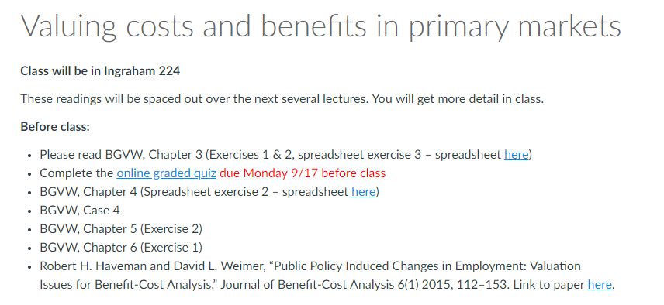
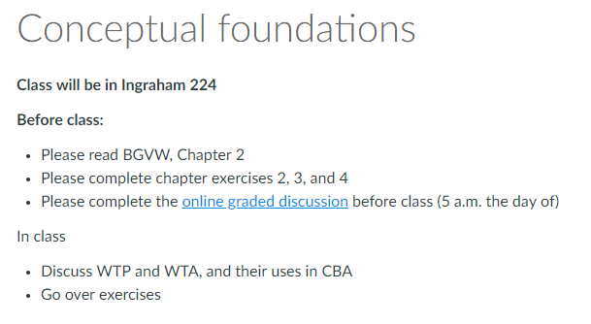
Before next class
Notes:
Online graded discussion due morning before class
For some topics, there is a lot of reading listed but it’s for several lectures.
We will try to be clear in class about what to read for when

